Slide 1
ACADEMIC & CAREER ROADMAP
IBM Certification Blueprint
A structured 4-year progression matrix for high-impact software, cloud, data, and AI careers.

Slide 2

STRATEGIC VISION
Industry-Aligned Skill Growth
8
Foundation to Specialization
Core programming precedes cloud systems.
Semesters of Practical Badges
Enterprise Credentials
Gradual transition from algorithmic logic to enterprise cloud and GenAI.
Globally recognized IBM digital badges.

Slide 3
HIERARCHY MATRIX
Certification Priority Tiers
TIER 1: CORE
TIER 2: APPLIED
TIER 3: ADVANCED
Essential Foundations
Systems & Deployments
AI & Cloud Architecture
• C/C++ Software Foundation
• IBM Cloud Fundamentals
• Generative AI Essentials
• Python Programming
• Node.js & REST APIs
• Docker & Kubernetes
• SQL 101 & Relational Databases
• Cybersecurity Basics
• Deep Learning with TensorFlow

Slide 4
ACADEMIC BLUEPRINT • YEAR 1
Core Logic & Programming Basics
SEM 01
Computational Thinking
SEM 02
Data Foundations
C / C++ Software Foundation
Python Programming
Memory management mastery.
Syntax fluency and scripting.
HTML5 & JavaScript Basics
SQL 101 & RDBMS
Interactive browser frontend design.
Relational schema architecture.

Slide 5


ACADEMIC BLUEPRINT • YEAR 2
Full-Stack & Cloud Essentials
SEMESTER 03
Java, Node.js & MongoDB
Scalable backend microservices.
SEMESTER 04
IBM Cloud & Agile Workflows
Enterprise sprint execution.

Slide 6
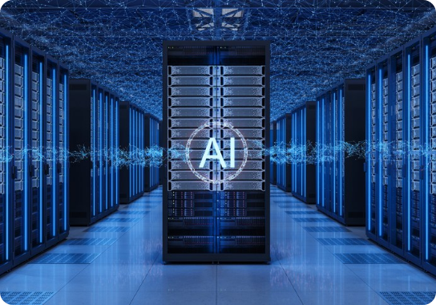
ACADEMIC BLUEPRINT • YEAR 3
DevOps, Data & Cybersecurity
SEMESTER 05
Data Science & Security
Proactive threat prevention.
SEMESTER 06
Kubernetes, Docker & IAM
Automated container orchestration.

Slide 7
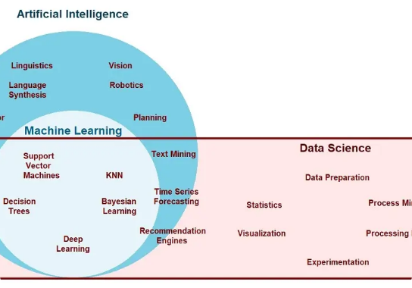
ACADEMIC BLUEPRINT • YEAR 4
Enterprise AI & Big Data
SEMESTER 07
Deep Learning & Hadoop Spark
Massive distributed stream processing.
SEMESTER 08
Generative AI Essentials
Production-grade foundation models.

Slide 8
INDUSTRY APPLICATION
Data Engineering & Analytics
ETL Pipelines
Visual Telemetry
Spark Streams
Automated high-throughput data extraction.
Real-time operational dashboard analytics.
Distributed low-latency computation clusters.

Slide 9
INDUSTRY APPLICATION
AI & Deep Learning Tracks
Neural Vision
GenAI Agents
Forecasting
Automated visual defect inspection.
Task-oriented enterprise Copilot integrations.
Predictive inventory optimization models.

Slide 10
INDUSTRY APPLICATION
Cloud Architecture & Security
Zero-Trust Access
K8s Clusters
CI/CD Pipelines
Role-based credential authorization policies.
Resilient zero-downtime microservice clusters.
Continuous integration testing workflows.

Slide 11
MEASURABLE IMPACT
Career Readiness Outcomes
3.2x
100%
4
Shortlist Rate
Verified Credentials
Specialized Tracks
Accelerated technical screening approvals.
Cryptographically verifiable digital badges.
Cloud, AI, DevOps, and Data.

Slide 12
ROADMAP NEXT STEPS
Launch Your IBM Certification Plan
Align your semester curriculum with industry badges for maximum technical competency.

Slide 13



Image Sources
https://images.presentationgo.com/2025/04/software-developer-coding-laptop.jpg
Source: www.presentationgo.com
https://www.databank.com/wp-content/uploads/2026/08/What-Is-a-Neocloud-AI-First-Cloud-Infrastructure-Explained.jpg?w=724
Source: www.databank.com
https://www.ejable.com/wp-content/uploads/2023/11/AI-DS-ML-2.webp
Source: www.ejable.com

